Slide 1
Emulate an Attack
By: Samiksha Regmi
Tutor: Clinton hayes
Unit coordinator: Jamie shield

Slide 2
1. T1053.005: Scheduled Task/Job
Queries the "Microsoft-Windows-Sysmon/Operational" log using Get-WinEvent.
Filters events associated with the establishment of "T1053" (scheduled tasks).
Time Created: The precise event tracking timestamp.
Process ID: A unique identifier for the relevant process.
Targeted registry path is displayed by the registry key.
User Account: NT AUTHORITY\SYSTEM was used for operations.
continue.. Fig next page

Slide 3
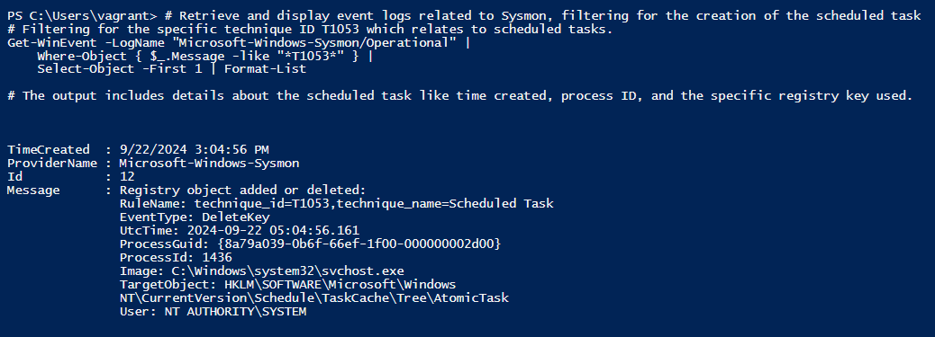
T1053.005: Scheduled Task/Job

Slide 4
Powershell Cmdlet Schedule Task
'calc.exe' (the Calculator software) is executed.
Setup Trigger: The task begins when the user logs in.
Principal Configuration: Operates under the Administrators group with the greatest level of rights.
'AtomicTask' is the name of the registered task.
Confirmation: The output message attests to the creation and registration processes' success.

Slide 5
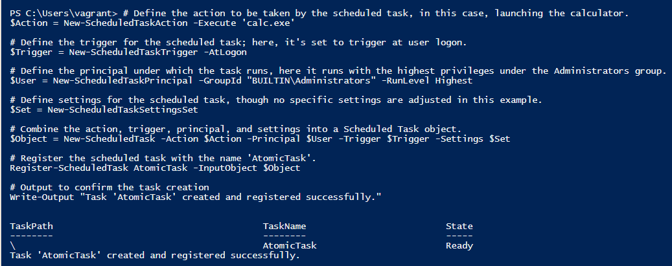
Powershell Cmdlet Schedule Task
Attack Commands

Slide 6

Powershell Cmdlet Schedule Task
Cleanup Command
The above given command is the cleanup command which displays a PowerShell command for removing a scheduled task named "AtomicTask".

Slide 7
2. T1003: Credential Dumping
The goal of the PowerShell command is to identify and show Sysmon event logs related to credential dumping activity.
Log Retrieval: The command pulls logs from "Microsoft-Windows-Sysmon/Operational" using Get-WinEvent.
Filtering: "T1003" items, which are linked to credential dumping, are filtered out of logs.
The first significant log object is formatted for better viewing using the following output command: Select-Object -First 1 | Format-List.

Slide 8
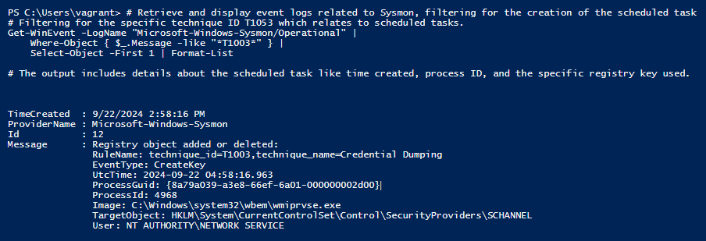
T1003: Credential Dumping

Slide 9

Dump Credential Manager using keymgr.dll and rundll32.exe
Attack Command
Use of the command: Opens the Windows Credential Manager.
Utilized Utility: rundll32.exe, an application for launching DLL file-based functions.
Keymgr.dll, which has features for handling network credentials kept on a Windows PC, is the DLL involved.
The specific function in keymgr.dll called KRShowKeyMgr is responsible for opening the Credential Manager interface.

Slide 10
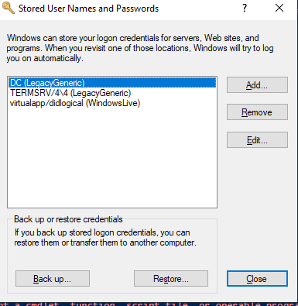
Dump Credential Manager using keymgr.dll and rundll32.exe
Manages and saves login information for later use automatically.
Displays stored credentials, including "TERMSRV/4/4 (LegacyGeneric)" and "DC (LegacyGeneric)."
Allows users change, add, or remove login information.
Offers choices for backing up and restoring login information, making it simple to move between computers.

Slide 11
References
redcanaryco (2017). atomic-red-team/atomics/T1053.005/T1053.005.md at master · redcanaryco/atomic-red-team. [online] GitHub. Available at: https://github.com/redcanaryco/atomic-red-team/blob/master/atomics/T1053.005/T1053.005.md [Accessed 22 Sep. 2024].
redcanaryco (2017). atomic-red-team/atomics/T1003/T1003.md at master · redcanaryco/atomic-red-team. [online] GitHub. Available at: https://github.com/redcanaryco/atomic-red-team/blob/master/atomics/T1003/T1003.md [Accessed 22 Sep. 2024].
My GitHub: https://github.com/Samikshare

